Slide 1
HNDIT11062 – Web Development
Chapter6: E-Commerce Web Sites

Slide 2
E-Commerce
Electronic Commerce, commonly known as (electronic marketing) e-commerce or eCommerce, consists of the buying and selling of products or services over electronic systems such as the Internet and other computer networks.
Simply, e-commerce means doing business online.

Slide 3

Narrow definition
“ The activity of buying and selling products and services on the web”
“Using internet technologies to perform any business process”
E.g.
  Selling goods and services
  Collecting payments
  Ordering materials and supplies
  Hiring personal
  Shipping finished goods to customers
Broad definition

Slide 4
Electronic commerce
An Web server handles Web pages whereas an
  e-commerce server deals with the buying and
  selling of goods and services.
A Web server should handle e-commerce software
  since this simplifies adding e-commerce features
  to existing sites.
  E.g.
      Amazon.com
      Business.com
      seibei.com
      ebay.com etc.

Slide 5
Features of Ecommerce Web Sites
  Creation of graphics
  Product information
  Addition of new products
  Shopping carts
  Credit card processing
  Sales report generation
  Rich User Accounts
  Product Comparison
  Product Image Zoom-in Capability
  Versatile Shipping Options
  Advanced Marketing and Promotions Tools
  Analytics and Reporting
  Multiple Images Per Product

Slide 6
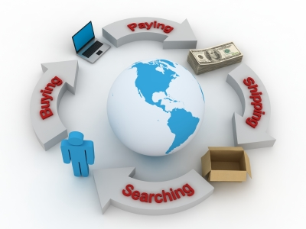
E-Commerce Process

Slide 7
Business applications
Some common applications related to electronic commerce are :
    Email
    Enterprise content management
    Instant messaging
    Newsgroups
    Online shopping and order tracking
    Online banking
    Online office suites
    Domestic and international payment systems
    Shopping cart software
    Teleconferencing
    Electronic tickets

Slide 8
Internet commerce
Information and communications technologies can also be used to advertise and make once-off sales of a wide range of goods and services.
This type of e-Commerce is typified by the commercial use of the Internet. The Internet can, for example, be used for the purchase of books that are then delivered by post or the booking of tickets that can be picked up by the clients when they arrive at the event.
It is to be noted that the Internet is not the only technology used for this type of service and this is not the only use of the Internet in e-Commerce.
The basic Internet elements used
for e-Commerce are:
  The client system using a browser
  The server holding the
  e-Commerce application
  Links from the Internet application
  to back office systems.

Slide 9
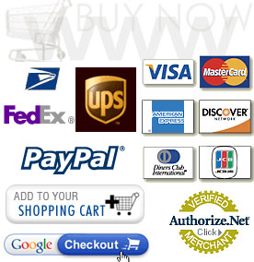
E- commerce payment methods
PayPal
Google checkout
iKobo etc.

Slide 10
Benefits of e-Commerce
Benefits to Organizations
  Global reach
  Cost reduction
  Supply chain improvements
  Extended hours:24*7*365
  Customization
  New business models
  Lower communication cost
  Improved Customer relationships
  No city business permits and fees
Benefits to Consumers
  More products and services
  Information availability
  Cheaper products and services
  Instant delivery
  Participation in auctions
  Electronic communities

Slide 11
Limitations of e-Commerce
Technological Limitations
  Lack of universally accepted standards for quality, security, and reliability.
  Insufficient telecommunication bandwidth
  Software development tools are still evolving.
  Special web servers are needed in addition to the network servers.
Non Technological Limitations
  Lack of trust
  Varying international government rules
  Some customers like to feel and touch products.
Barriers of e-Commerce
  Security
  Trust and risk
  Lack of qualified personal
  Organizational culture
  Fraud
  Legal issues

Slide 12
Chapter Review
What is e-commerce?
Give examples.
What is the meaning of e-governance? Briefly explain.

